Slide 1


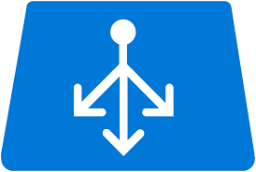



Azure 3-tier Architecture
External Load Balancer
Virtual Network
Web Server Subnet
Internal Load Balancer
App Server Subnet
Database Subnet

